Slide 1
Gallery and Student Activities
Student Achievements

Slide 2
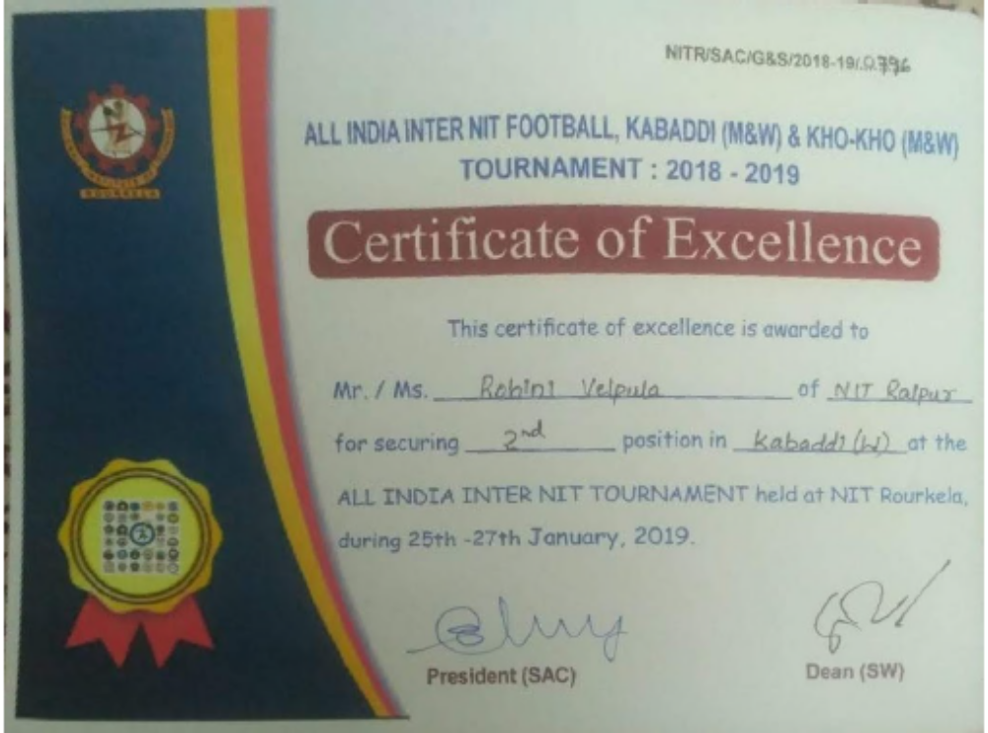
Hooray to Rohini Velpula for doing NITRR proud at the inter NIT tournament held at NIT Rourkela

Slide 3
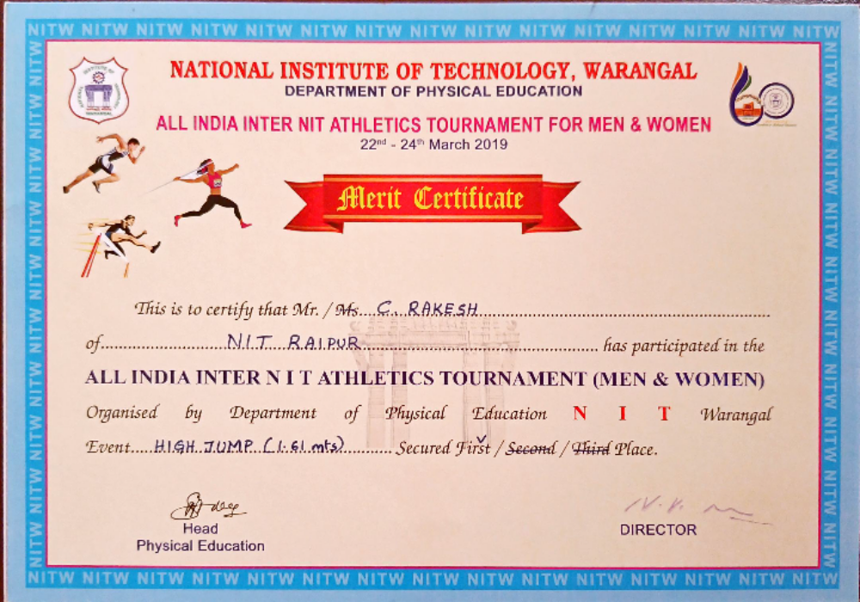
Hooray to Rakesh for securing 1st place in HIGH JUMP at the inter NIT tournament held at NIT Warangal

Slide 4
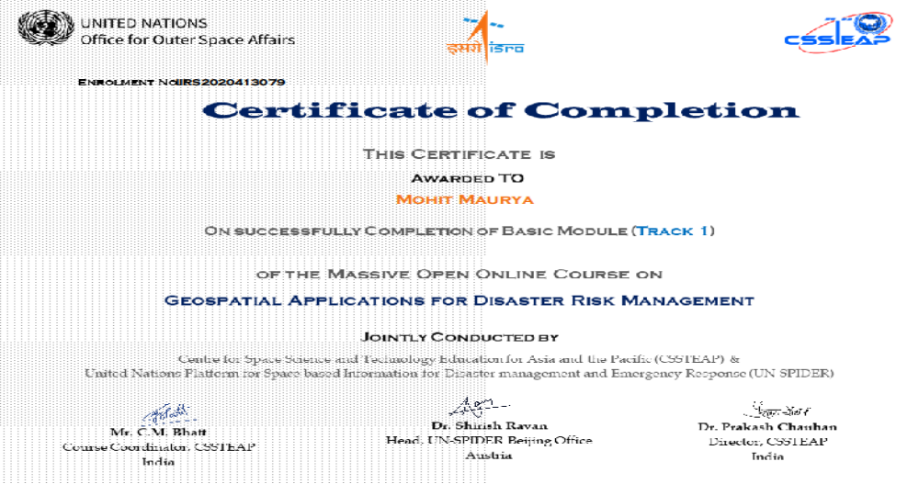
We congratulate Mohit Maurya for this proud achievement

Slide 5
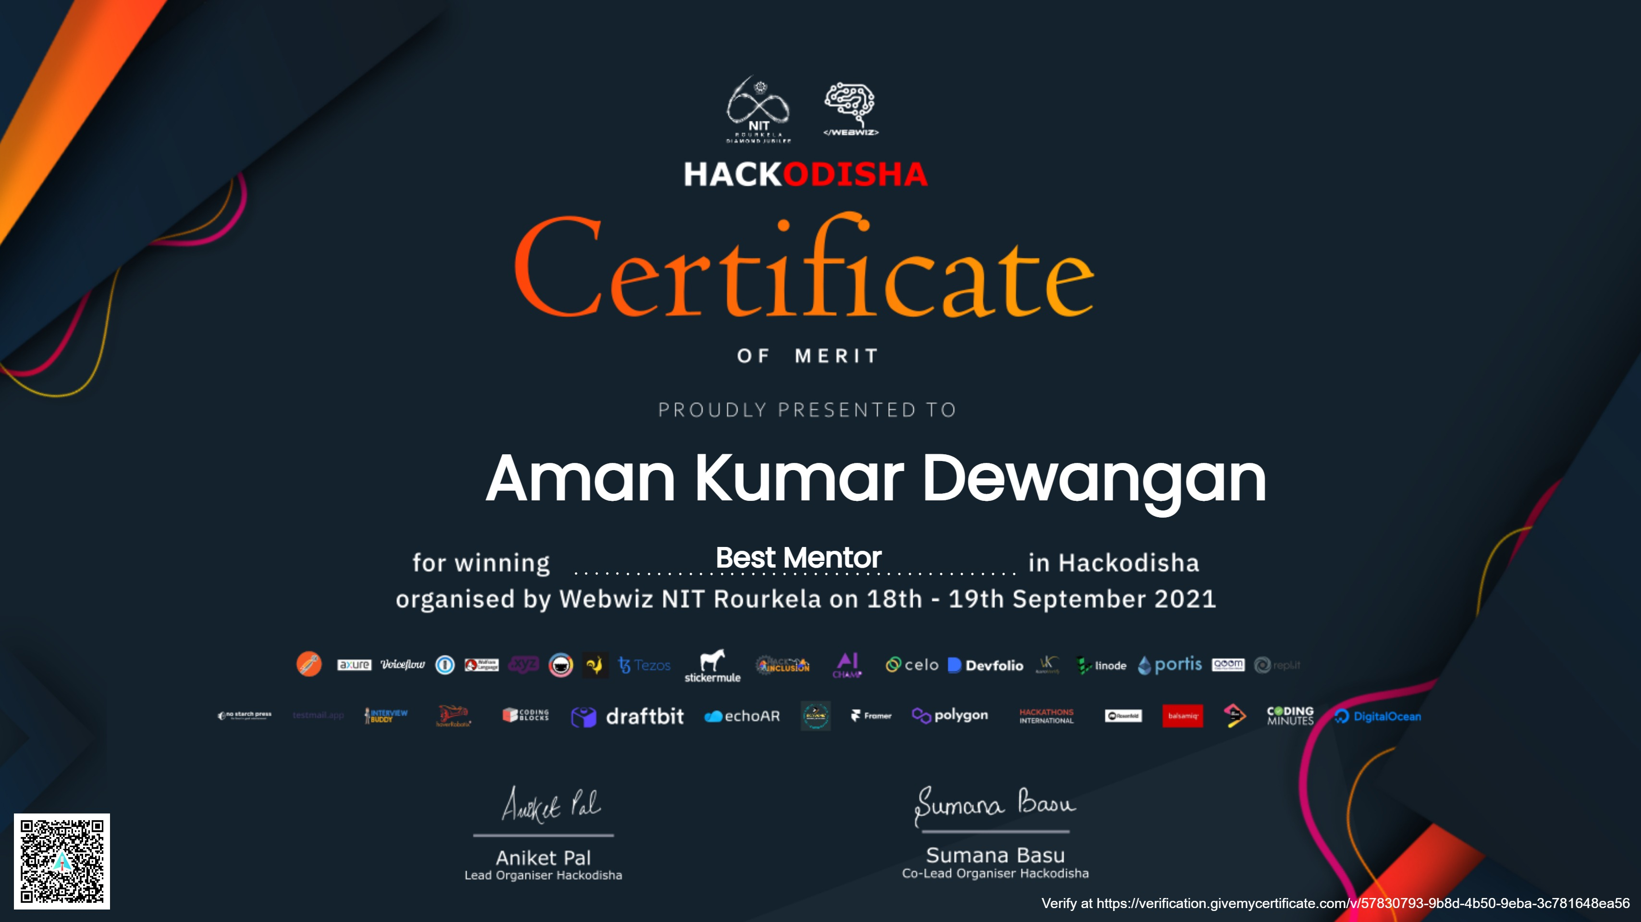
Aman Kumar Dewangan wins Best Mentor in Hackthon- Hackodisha organized by WEBwiz NIT Rourkela !!!

