Slide 1
Efficient Publication Strategy
Notes:
Now that we are reviewed about logically structuring your ideas throughout your manuscript, let us now discuss your publication strategy.
The main purpose of this section is to help you understand the thought process you need to go through in deciding the type of journal that is most suitable for your study.

Slide 2
Publication goals
Publish quickly and have impact in the field
Choose the most appropriate journal
Communicate study’s relevance
Notes:
Your goals are to publish quickly and have impact in the field. This is how you build your reputation and advance your careers.
To do this, you need to choose the most appropriate journal and communicate the relevance of your study to the journal editor.

Slide 3
Choose the appropriate journal
Is this the journal with the highest impact factor?
Not necessarily
It is the journal that will best reach your target audience to maximize your impact in the field
Notes:
Many younger authors think that their goal is to publish in the journal with the highest impact factor. That is wrong!
Your goal is to be widely read, that is how you have impact. To do that, you have to be sure you publish in the journal that will allow you to be most widely read. In other words, which journal will allow you to best reach your target audience.
Just because you publish in a high impact factor journal, that does not mean your article will be widely read. And if it is not widely read, it will not have impact. Focus on the impact of your article, not the impact factor of the journal.

Slide 4
Choose the appropriate journal
Where are the findings relevant?
Worldwide
Choose an international journal to reach a worldwide audience
Locally
Choose a regional journal to reach a local audience
Notes:
The easiest assessment you can make is where are your findings relevant.
If your findings are useful for researchers worldwide, then you should choose an international journal
However, if your findings are only useful for researchers in your specific area (e.g., Asia Pacific), then you should choose a regional journal. It may be hard to convince an international journal editor that your regionally specific findings will be of interest to readers in Brazil!
If you do have regionally specific findings, but you feel they are useful worldwide, then an international journal will be appropriate. However, you will need to clearly explain this in your manuscript and in your cover letter to the journal editor.

Slide 5
Choose the appropriate journal
For whom are the findings relevant?
Your field only
Choose an specialized journal to reach readers in your field
Your and other fields
Choose a broad-focused journal to reach readers across disciplines
Notes:
You need to decide who will be interested in reading your findings; who do you want to influence?
If you are trying to reach only readers in your specific field, than a specialized journal will be appropriate.
However, if your findings will have impact for researchers in other fields too, then a more broad-focused journal will be more appropriate to reach these readers.

Slide 6
Choose the appropriate journal
How much accessibility do you need?
Subscription
Only academics with access to the journal can read your article
Open access
Freely available to everyone worldwide
Notes:
There are two publishing models authors can choose: subscription or open access journals.
Subscription journals are often more established in the field (because they are older) and do not charge fees to publish articles. However, keep in mind that by publishing in these journals, you restrict access to your findings to only those academics who’s universities subscribe to that journal.
If you want your findings to be more widely available worldwide, then open access would be a more appropriate publication model. But the benefits of open access are not restricted to increased accessibility…

Slide 7
Benefits of open access
Fulfill funder or institutional mandates
Increase accessibility to your findings worldwide
Increase the number of downloads of your article
Allows you to retain the copyright to your work
Published quickly online
Fewer restrictions on word and figure limits
Notes:
Open access may be useful for you for many reasons.
May have mandates that you need to satisfy for your grant and or institution
Increased accessibility is not only useful for people outside of academia, but also for academics in emerging markets where their universities do not have funding for subscriptions (so if your results are specifically useful for emerging markets, open access would be important)
Subscription journals require you to transfer the copyright of your article to the publisher. If you want to retain it, then open access is important.
Because OA journals are online only, they often do not need to wait for the next printed issue to publish your article. Therefore, they can publish more quickly online.
Because OA journals are online only, they often have fewer restrictions on word and figure limits. Subscription journals have these limits to ensure each published printed issue is not too large.

Slide 8
Not all open access journals are good
How to identify a trustworthy journal?
Reputable publisher
Springer Nature, Elsevier, PLoS, etc.
Editorial board
International and familiar
Indexed
Indexed by common databases
Authors
Do you recognize the authors?
Fees
Only paid after acceptance
Notes:
However, not all open access journals are good. There are some that promise quick and easy publication for a fee. Do not trust these journals!
How do you identify a trustworthy journal?
First, check the publisher. If it is from a reputable publisher, like Springer Nature, than you can be confident that it is a good journal.
Also check the editorial board. They should have a list of international experts with some names that are familiar to you.
You can also check where the journal is indexed. For example, is it listed in the Directory of Open Access Journals? If so, it’s likely a good journal. But also is it indexed in the databases that researchers in your field use to find articles, like Web of Science or Scopus? If not, even if it is published, no one will find it. Always ensure your journal is indexed properly.
Look at recently published articles in the journal. Where are the authors from? Do you recognize the universities? Do you recognize the names? If so, you can have more confidence that others in your field are also publishing in this journal.
Lastly, almost all open access journals only charge a fee after acceptance. If a journal asks for a submission or publication fee, you need to be careful.

Slide 9
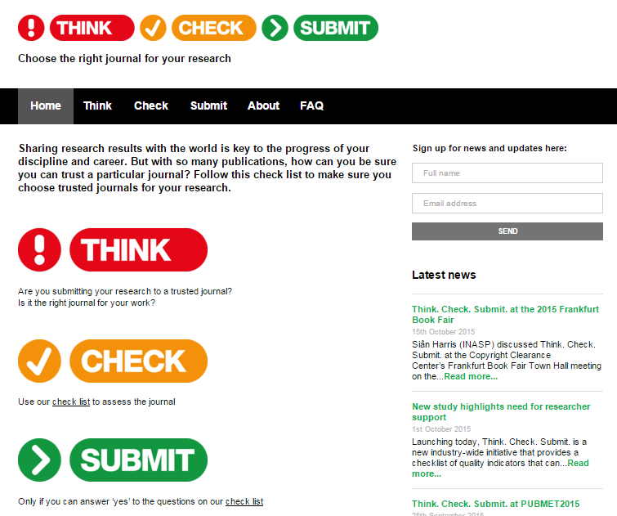
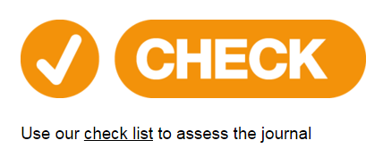
Think – Check – Submit (www.thinkchecksubmit.org)
Notes:
An excellent and free resource available to authors is Think-Check-Submit.
This website will help you check whether a journal is trustworthy and appropriate for your manuscript.
Simple click on this link [‘Check’]

Slide 10
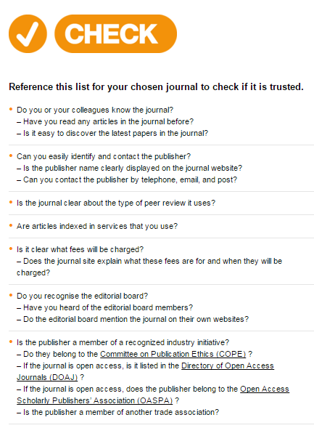
Think – Check – Submit (www.thinkchecksubmit.org)
Only submit to a journal if you can answer yes to all of these questions!
Notes:
And they will giveyou a nice check list that you can use.
Only if you can answer yes to all of the questions should you feel comfortable submitting to the journal.
So I strongly encourage you to use this free resource if you ever doubt a potential journal.

Slide 11
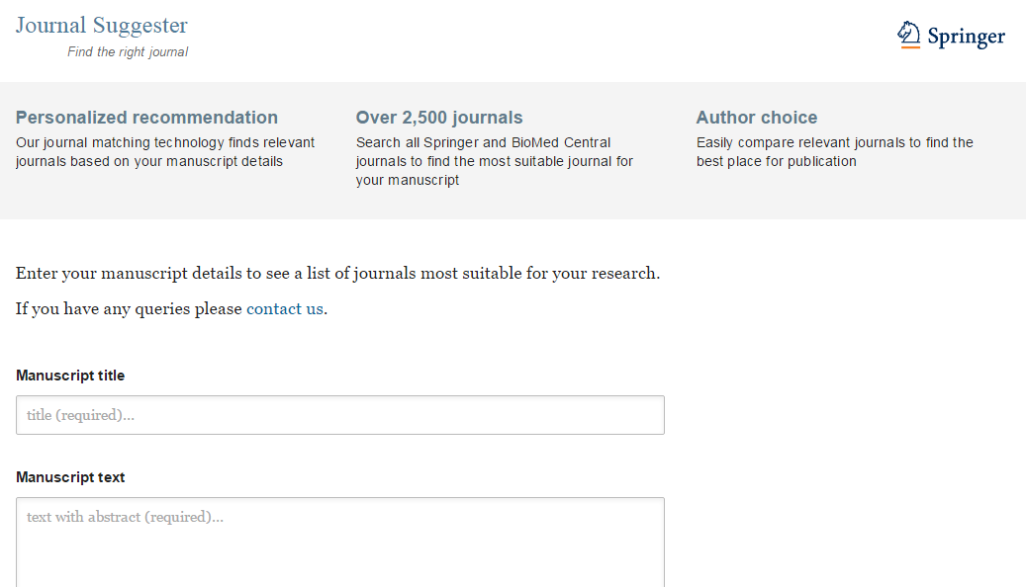
Need help finding a journal?
Springer Journal Suggester
journalsuggester.springer.com
Notes:
However, a key problem is that you have many journals to choose from! Luckily, there are free online databases you can use to help you find an appropriate journal. Springer has one called the Journal Suggester, which you can find at this URL. With the Journal Suggester, you can search through over 2500 journals in our portfolio to find one that may be appropriate for you manuscript.

Slide 12

Appropriate journal
Logically organized manuscript
Ready to submit!
Notes:
So we have now discussed how to choose an appropriate journal and how to logically organize your ideas in your manuscript.
Now you are ready to submit!

